Slide 1
Python Project:
Speed Dating
Caroline Nelson, Billy Yuan, Liuxuan (Kelly) Yu, Lindsay Tober

Slide 2
Agenda
Data Overview
Preparing for Data Exploration
Data Exploration
What confounding variables might have an influence on desirability and compatibility?
What attributes have an influence on desirability and compatibility?
Solutions and Insights
How can you increase the chances of someone ‘liking’ you?
How can you increase the chances of someone matching with you (mutual ‘likes’)?

Slide 3
Data Overview
What did the data set include?

Slide 4
Data Overview
The Speed Dating data set was based on a study at Columbia over the course of several months, and several sessions, or waves.
Initial Survey
Speed Dating Activity
Decision Surveys
Follow-up Surveys
Age
Gender
Race
Background
Education
Career
Interests
Important attributes for a partner
Attitudes towards event
Different sets (‘waves’) of men and women participating in speed dating events
21 ‘waves’ from October 2002 to April 2004 (some of our analysis excluded waves 6-9 given different rating scale)
Rating partners on a scale of 1-10 across 6 attributes
Decision of yes / no (both partners saying ‘yes’ gives a match)
How yes / no decisions were made
Details on ‘match’ conversions to dates
Focus of our analysis
Notes:
1 min

Slide 5
Speed Dating Overview
A total of 4,184 dates took place over 21 ‘waves’ of speed dating from October 2002 to April 2004
274 Women
Key Attributes:
Attractiveness
Sincerity
Intelligence
Fun
Ambition
Shared Interests
⚢
277 Men
⚦
4,184 Total
‘Speed Dates’

Slide 6
Preparing for Data Exploration
What skews are present in our data set?

Slide 7
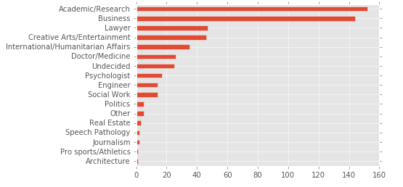
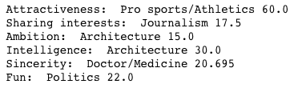
Looking at our Sample Population...
The data set is biased towards the audience of NYC, which is heavily populated with the top 6 career types listed.
Top Career by Attribute Ratings:

Slide 8
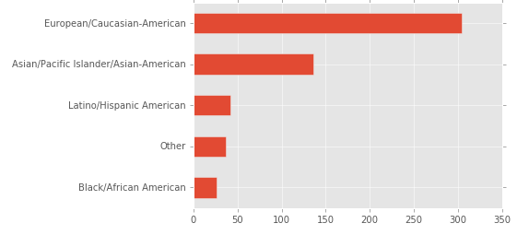
Skews in Participant Race
Close to 80% of the participants were either Caucasian or Asian.
Keep in mind these are only initial observations on the data set. We will see later if race and other factors actually impacted decisions, and therefore, matches.

Slide 9
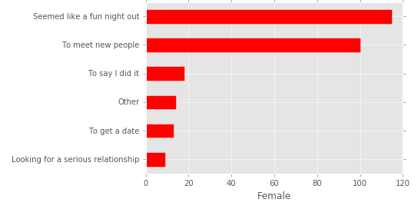
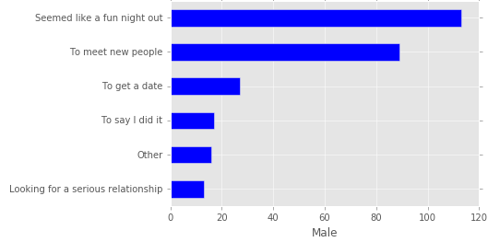
Girls (& Guys) Just Wanted to Have Fun
The majority of people came to speed dating to have fun and meet new people, and there is no difference between males and females.

Slide 10
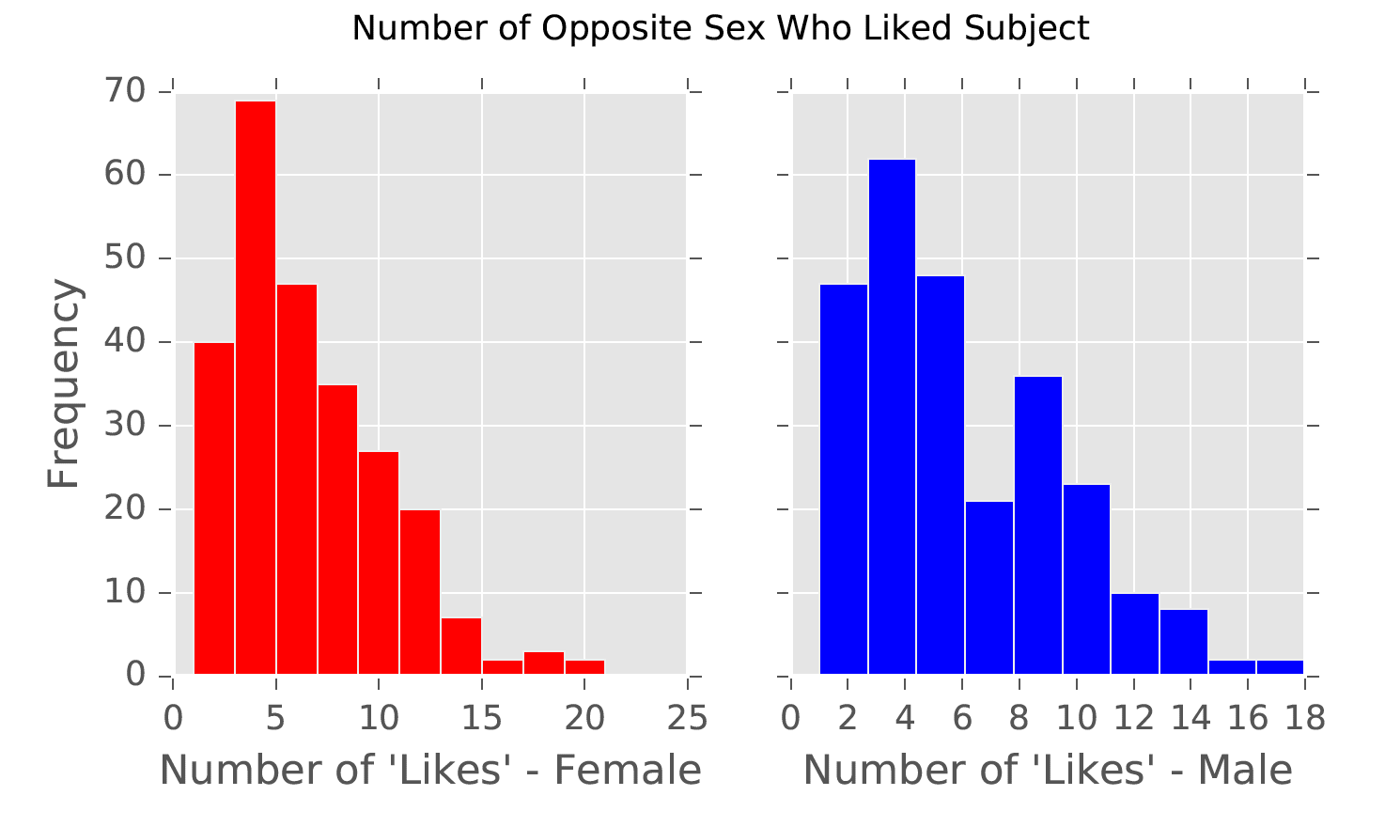
Attraction is Not Gaussian
The distributions of the number of ‘likes’ for both men and women have a right skew.

Slide 11
Data Exploration
What confounding variables might have an influence on desirability and compatibility?

Slide 12
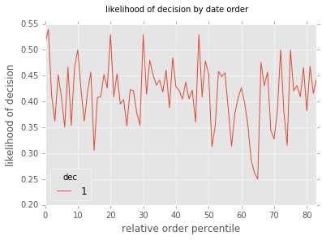
Does Order Matter?
Order doesn’t influence whether your partner wants to date you; there is no significant difference between first or last.

Slide 13
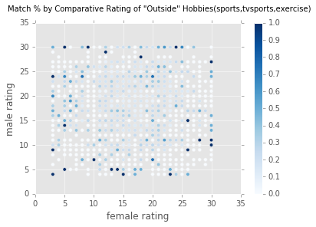
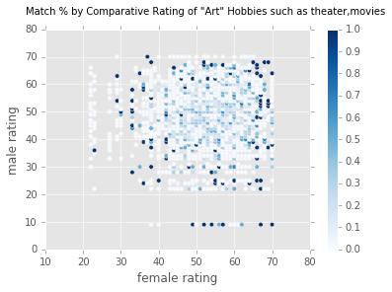
Do Hobbies Matter?
People with the same hobby score don’t necessarily have higher match rates.

Slide 14
Does Race Matter?
Regardless of race, people had close to a 40% chance of getting a ‘yes’.
Impact of Race Pairing on Decision Likelihood
Decision | Same Race | Different Race
Yes | 1,439 (43.4%) | 2,076 (41.0%)
No | 1,877 (56.6%) | 2,986 (59.0%)
Attitudes may vary across the different races, but skews in data set did not allow for detailed comparison across races.

Slide 15
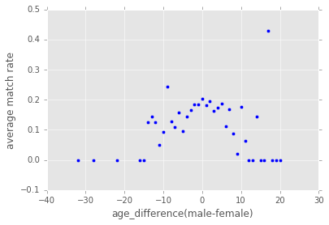
Does Age Matter?
People tend to match more frequently with others closer to their age - match rates tend to decrease as age differences increase.
Older men and older women are less frequent in the data, but still have less probability of getting a match.

Slide 16
Data Exploration
What attributes have an influence on desirability and compatibility?

Slide 17
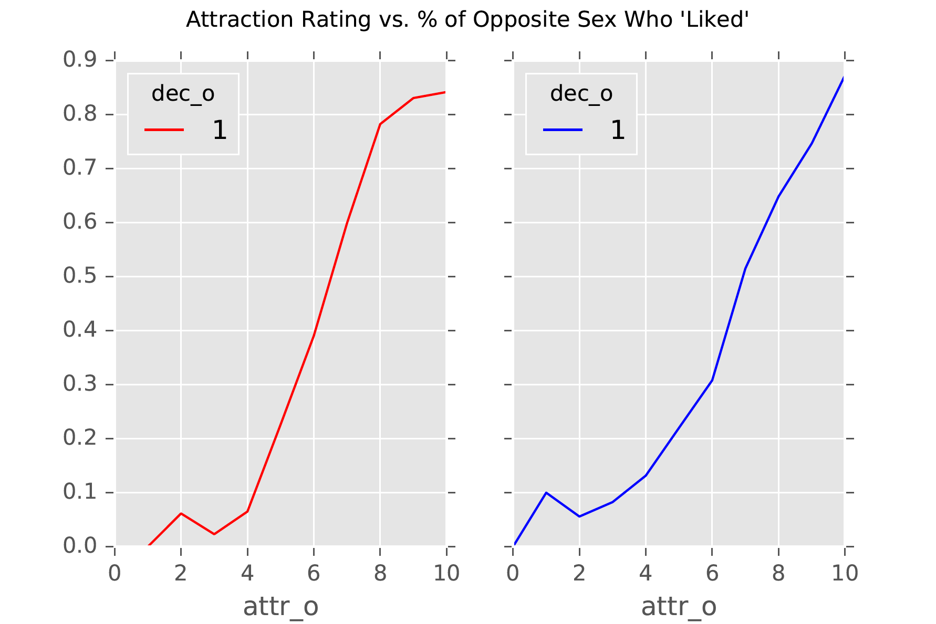
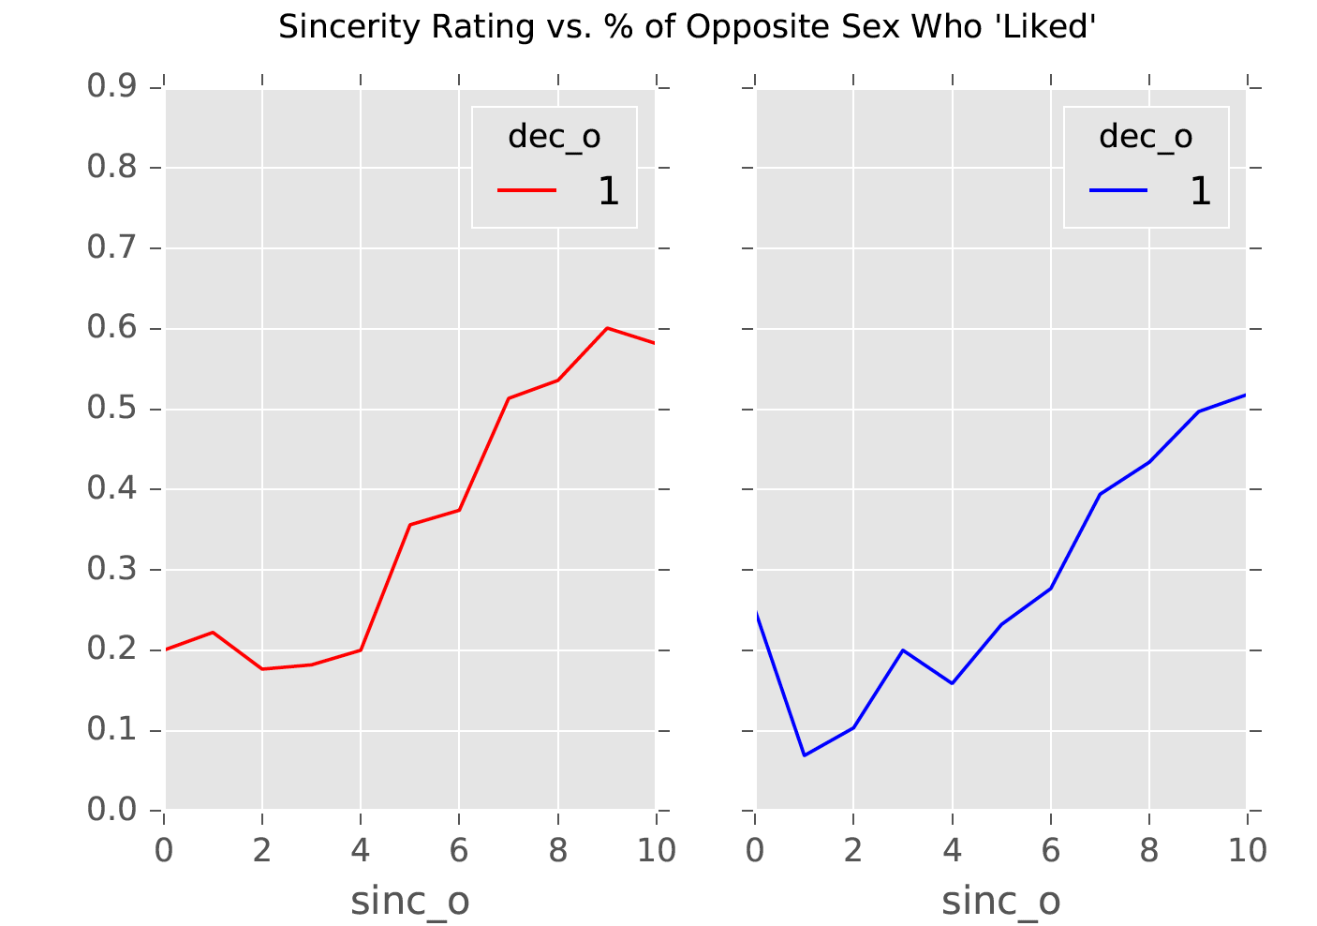
Looks are Not Deceiving
Attractiveness is the most important factor when deciding whether to “like” a partner
⚢
Women care about looks just as much as men
⚦
Being the nicest guy barely puts your chances above 50%
% opposites sex who ‘liked’
Female Attractiveness
Male Attractiveness
Female Sincerity
Male Sincerity
Notes:
The higher the rating, the higher the number of people who will like you.
Diminishing returns for sincerity; less so for women and men

Slide 18
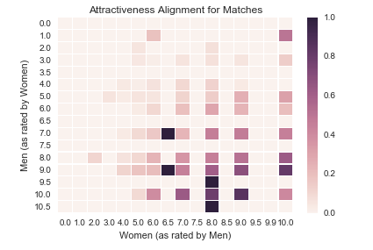
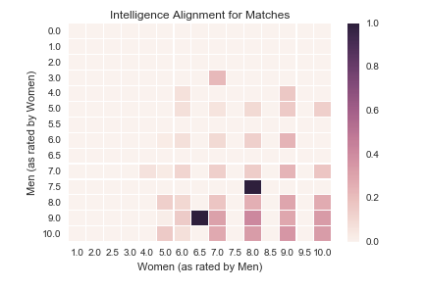
Attribute Alignment Shows Double Standards
Higher ratings across all categories are more likely to get matches, though intelligence is most banded
Attractiveness Alignment for Matches
Intelligence Alignment for Matches
Male 10’s don’t match with Women below 4
Intelligence was the most banded attribute by rating
Notes:
In general, ppl with higher ratings match together.
But women are more likely to match with men with lower attraction scores

Slide 19
Solutions and Insights
How can you increase the chances of someone ‘liking’ you?

Slide 20
Logistic Regression / Naive Bayes - No Magic Formula
Attractiveness and shared interests are the most important factors to getting a “like”
Variable | β(W->M) | β(M->W)
Attractive | .374 | .663
Fun | .290 | .264
Shared Interests | .243 | .277
Race (white) | .351 | -.110
Intelligence | .082 | -.037
Condition | W->M | M->W
Shared interests >= 7 | 1.000 | .970
Attractive >= 7 | .962 | 1.019
Fun >= 8 | .753 | .740
Race (white) | .286 | .176
Intelligence >= 7 | .258 | .259
β
P(A|B)
Logistic Regression
Naive Bayes
75%
Test Accuracy
73%
Test Accuracy
A woman’s attractiveness is significantly more important to men
When conditions are independent, women and men seem to share criteria
Baseline accuracy (men): 62% (negative class)
Baseline accuracy (female): 51% (positive class)
Notes:
Score high in attractive, fun, shared interests. However, men care about looks much more than women do.
Bayes doesn’t show difference in weights

Slide 21
Solutions and Insights
How can you increase the chances of someone matching with you (mutual ‘likes’)?

Slide 22
Logistic Regression on Matches - All the Cliches
Men and women both match on attractiveness, fun, and shared interests - though women match more with men looking for a serious relationship while men with lowkey, spontaneous women
Logistic Regression
(Attributes)
Broader Logistic Regression - Key Takeaways
(Attributes + Attitudes + Age + Race)
Women prefer men…
Looking for a serious relationship (1.602)
Who go on dates ~ 1x / week (0.805)
One of the biggest turnoffs for women?
Men speed dating ‘to say that I did it’ (-1.407)
Men prefer women…
Speed dating ‘to say that I did it’ (0.365)
That they find attractive (0.336)
One of the biggest turnoffs for men?
Women of a different race (-1.104)
...which could be skewed based on the data set
Variable | β(W->M) | β(M->W)
Attractive | .164 | .248
Fun | .272 | .245
Shared Interests | .235 | .227
Intelligent | -.041 | .034
Sincere | -.003 | -.119
Ambitious | -.145 | -.137
⚢
⚦
Baseline accuracy (men): 80.9% (negative class)
Baseline accuracy (female): 81.3% (negative class)

Slide 23
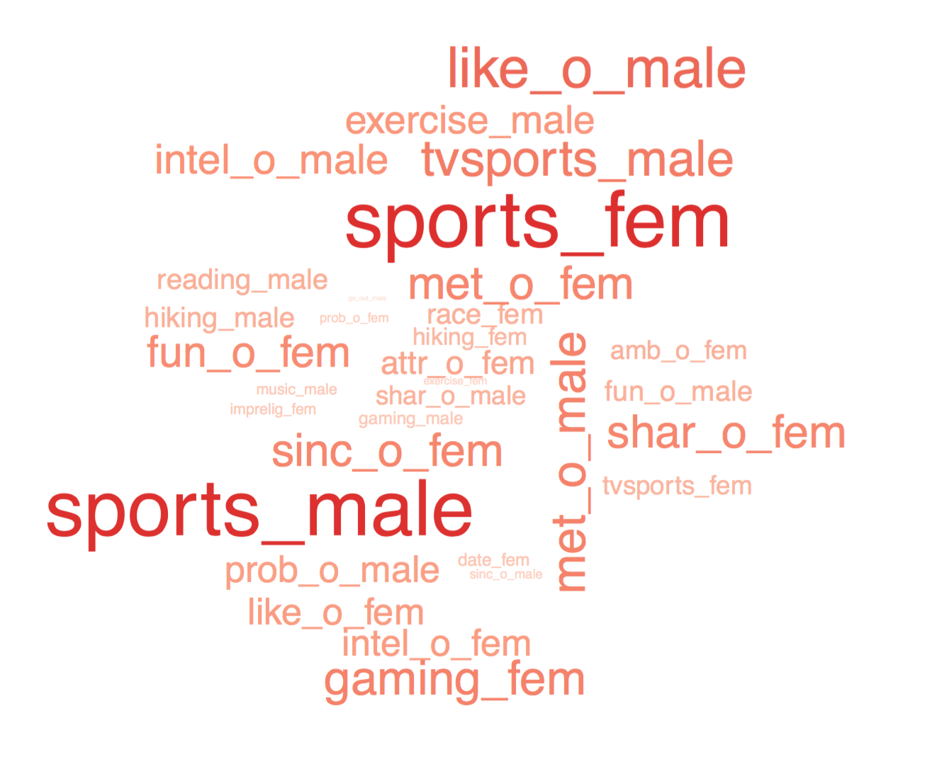
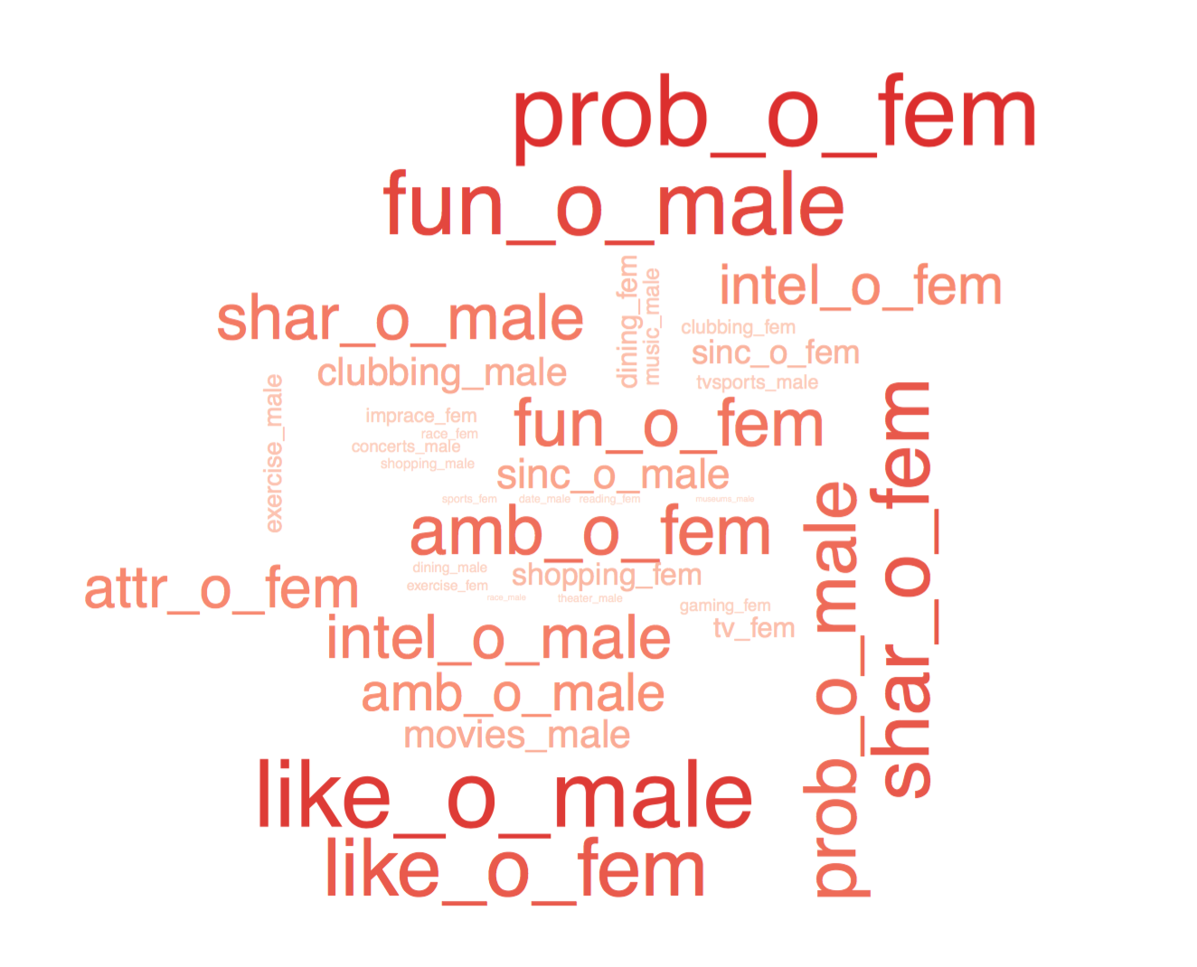
K-Means - Couples That Workout Together...
Clusters show that a mutual interest in fitness and complement personalities explain “matches”
Fitness Enthusiasts
Personality
Sharing an interest in sports could be a great icebreaker
Being fun, confident, and likable help make strong first impressions

Slide 24
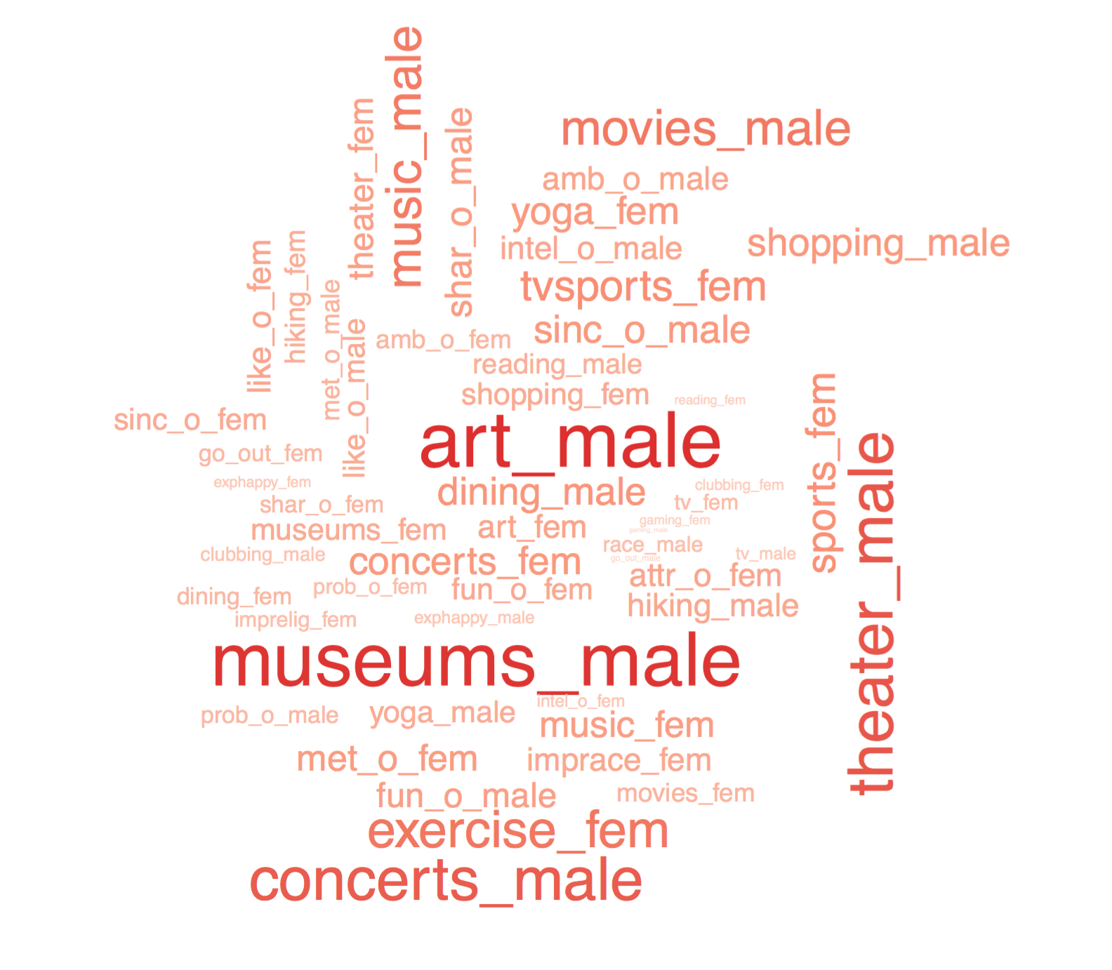
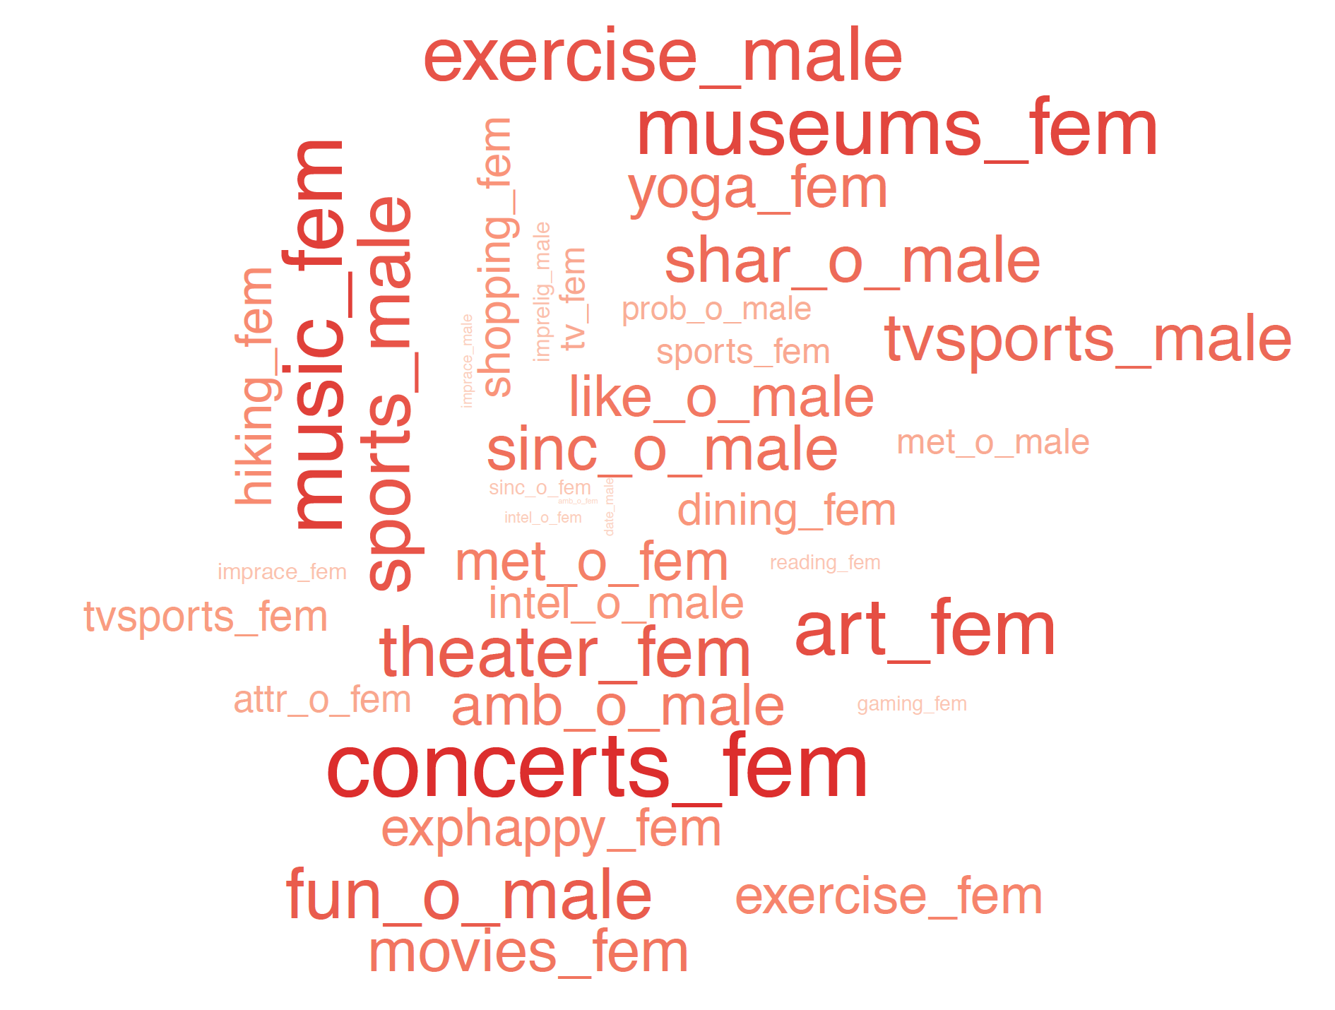
K-Means - Diverse Interests?
Other clusters are a little trickier to interpret
Mysterious Artists?
Eclectic Interests?
The clusters suggest that having shared interests outside sports isn’t always necessary when making a strong first impression

Slide 25
Model / Data Limitations

Slide 26
Clustering and Regression Limitations
Limited match data, skewed data, and survey bias hindered our ability to extract more nuanced insights
Limited Match Data
690 of 4184 speed dates, or 16.4% resulted in a match
180 possible dimensions
Missing Data in more specific dimensions such as date expectations
Skewed Data
80% of participants were either Asian or White
54.9% of participants were either in academia or finance/consulting
Survey Bias
All weights for the models presented relied on survey results from the participants

Slide 27
Questions?

